Slide 1
Network Layer

Slide 2
Agenda
Network Layer Introduction
Reaching destination
IP Header
IPv4 and IPv6 address
Network address translation
Routing protocols
Link state example
Distance vector example
OSPF and BGP 4
ICMP
Network level socket end point
Tasks for Today
References

Slide 3
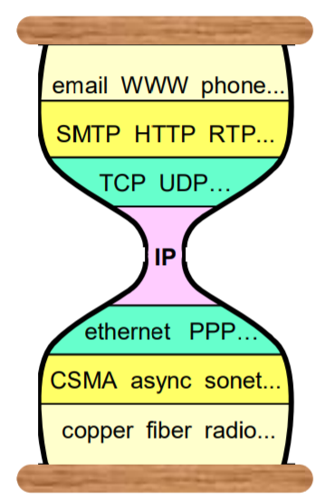
Network layer

Slide 4
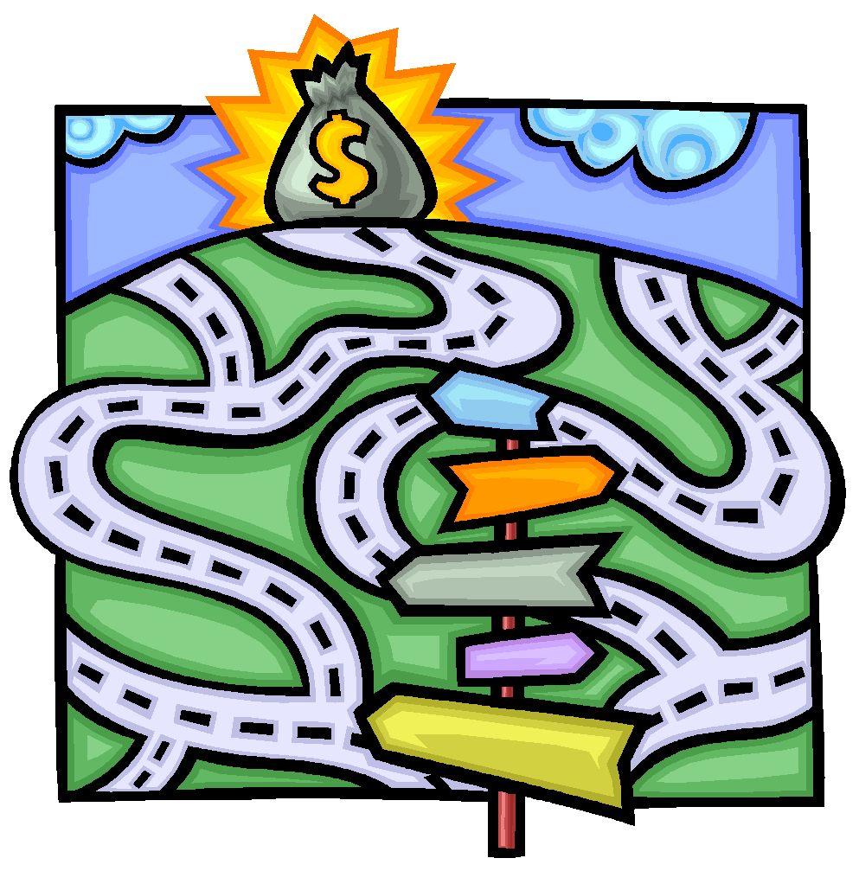

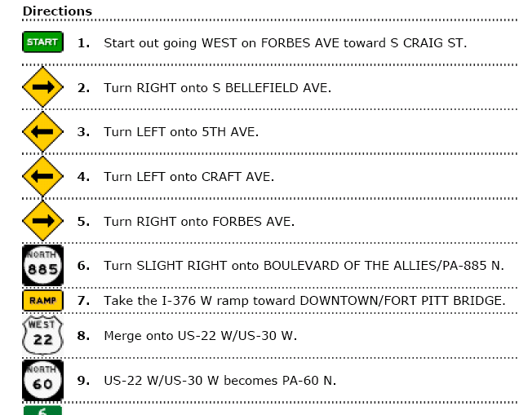

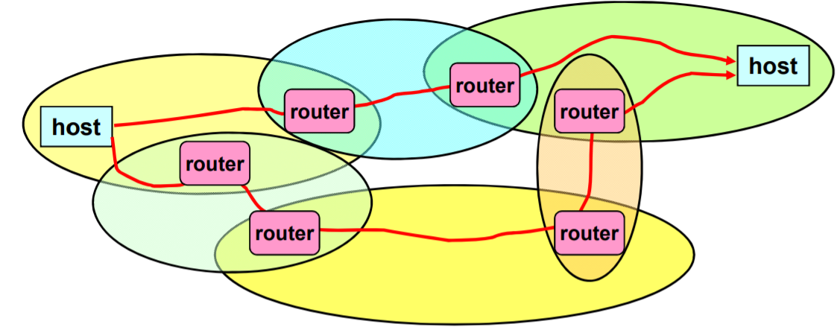
Reaching destination

Slide 5
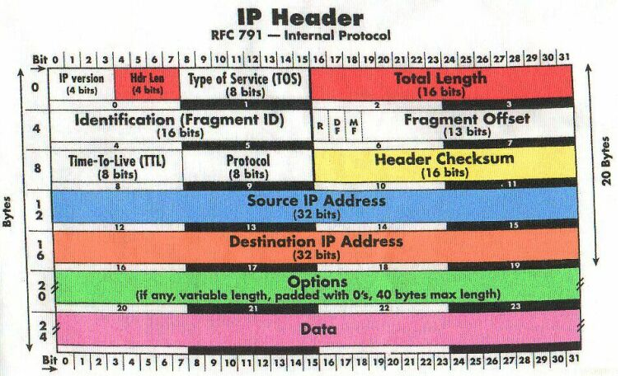
IP Header

Slide 6
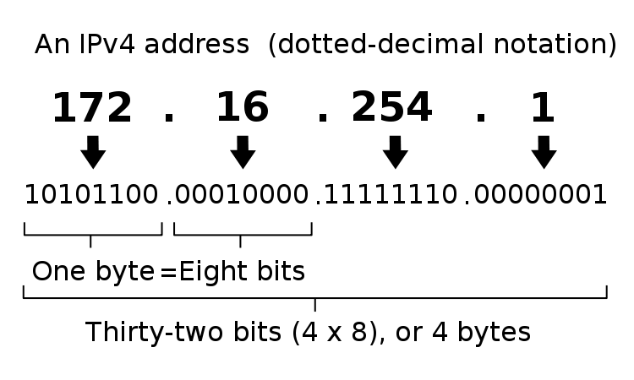
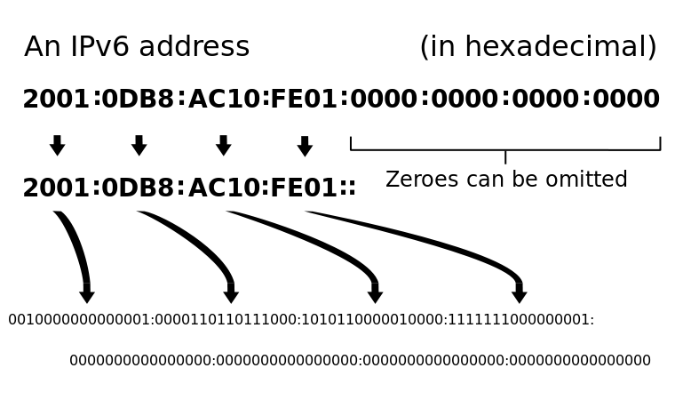
IP Address

Slide 7
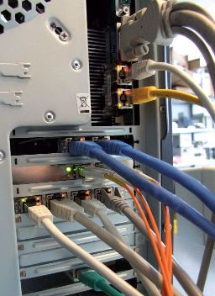
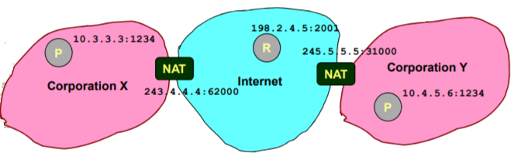
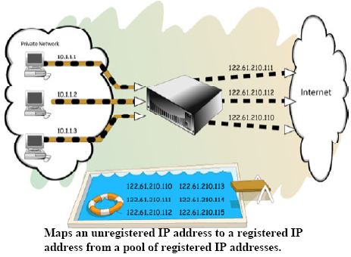
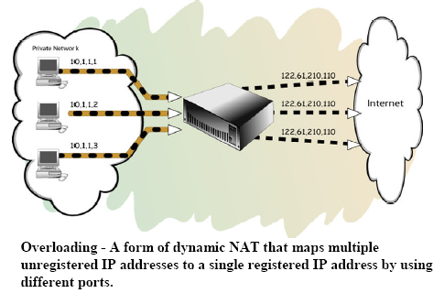
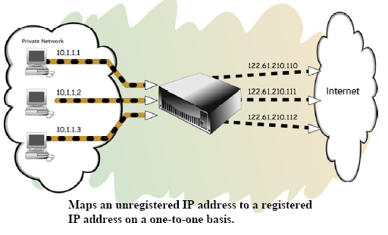
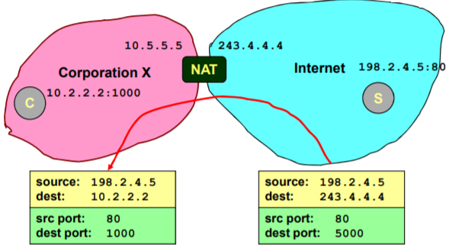
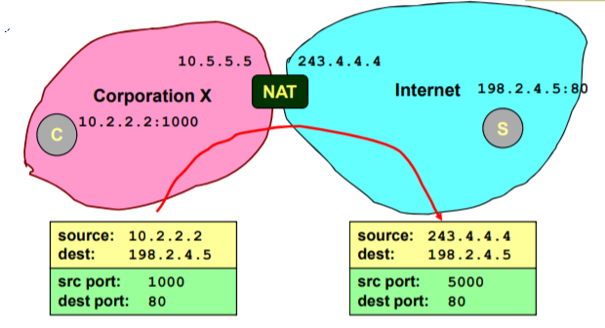
Network address translation
Translations between public IP addresses and internal network IP addresses for both incoming and outgoing traffic.
Hides internal network TCP/IP addresses and server / workstation configuration data.
Solves scarcity of IP addresses
Static, Dynamic, Port

Slide 8
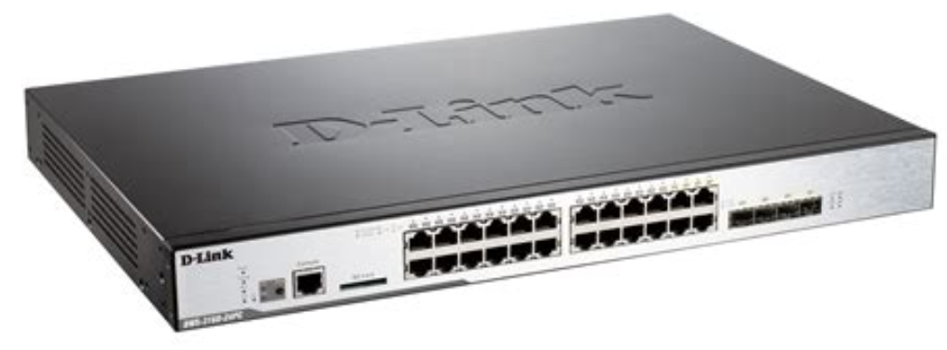
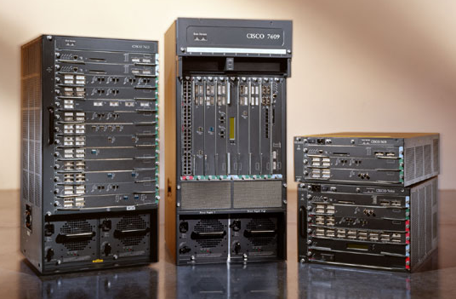
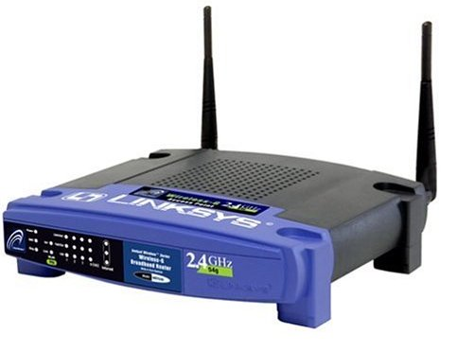
L3 device - the router
Hardware device capable of routing and forwarding.
Interconnection of separately managed networks.
Internet routing is sending packets from source to destination by hopping through networks.
Types of routing:
Source routing.
Table of Global destination addresses.
Virtual circuits.

Slide 9
Routing protocols
Link state based:
Link state is known by every other router.
Each router finds shortest path spanning tree to every other router.
Implements Dijkstra’s algorithm.
Every time a link fails, new link state spanning tree is calculated by flooding.
Distance vector based:
Routers do not know entire network, initial costs assigned to infinity and costs are added as the routes are discovered.
Calculates minimum cost spanning tree from each router based on neighbours routing tables.
Implements Bellman ford algorithm.
If links fails, routers calculate new loop free distances and converge.

Slide 10
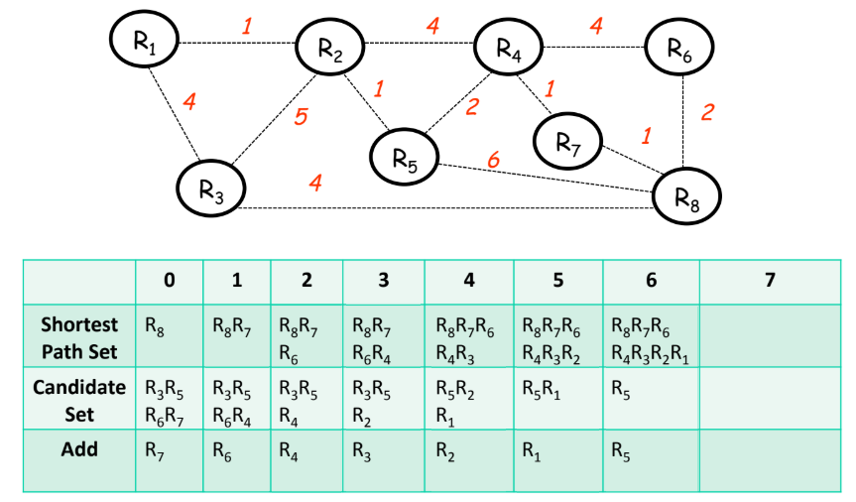
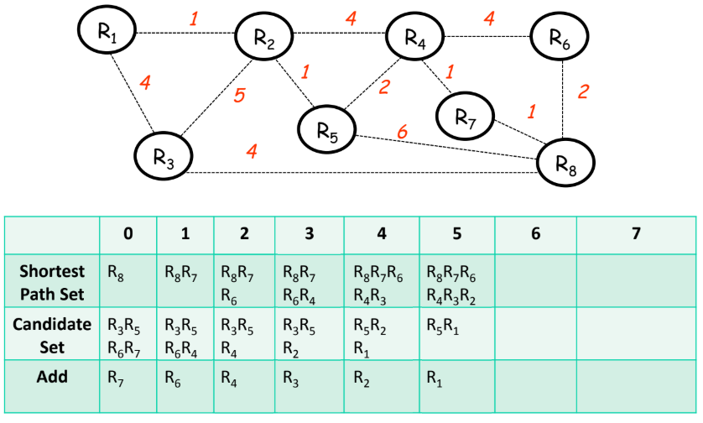
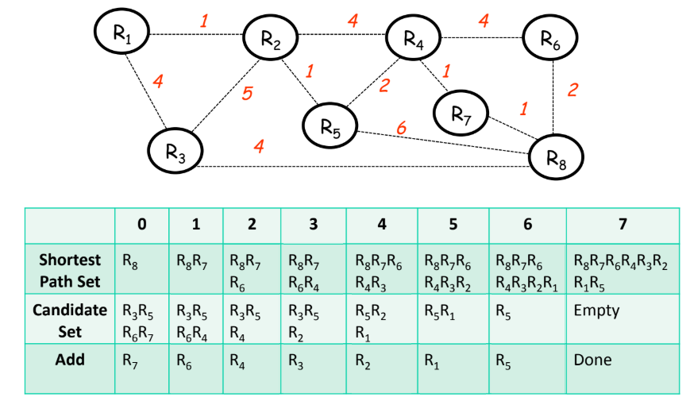
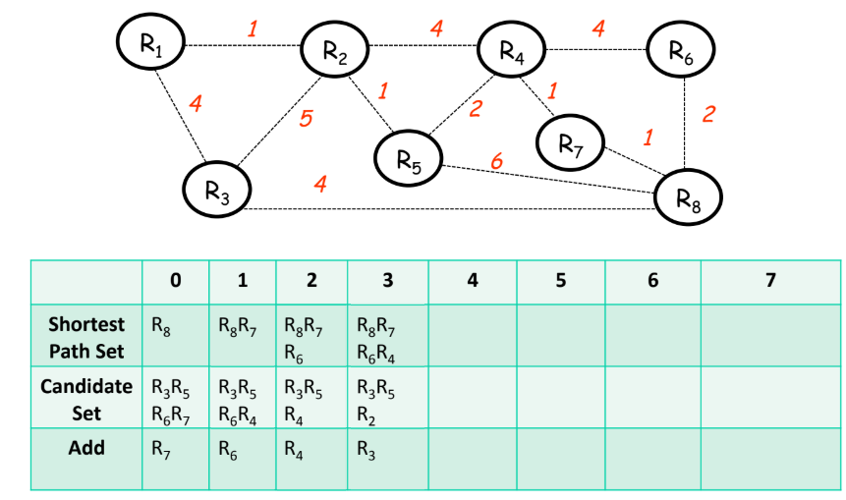
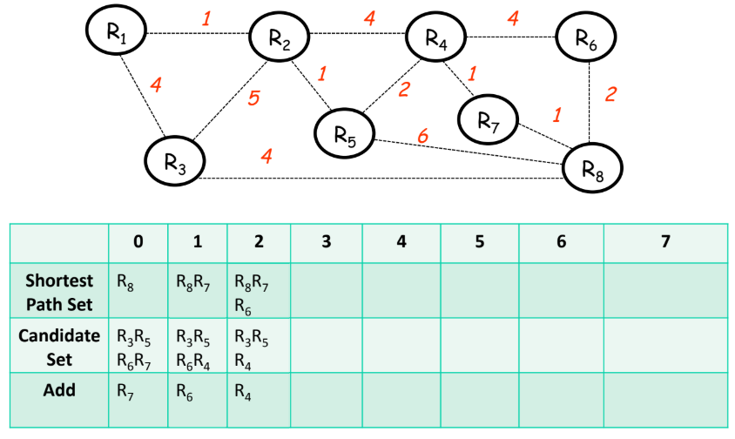
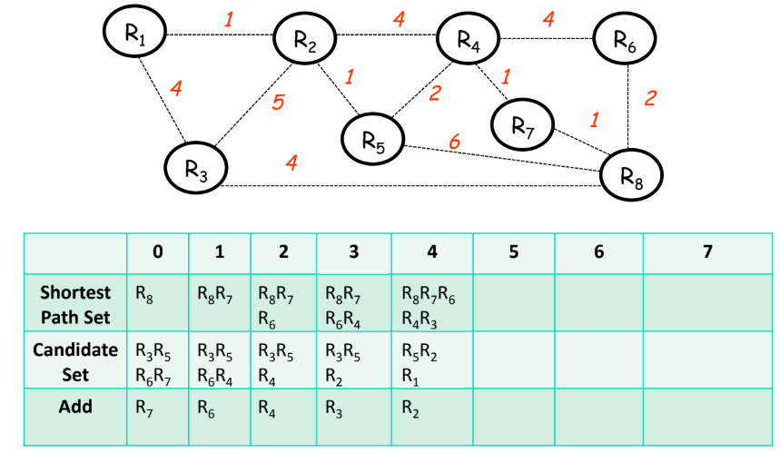
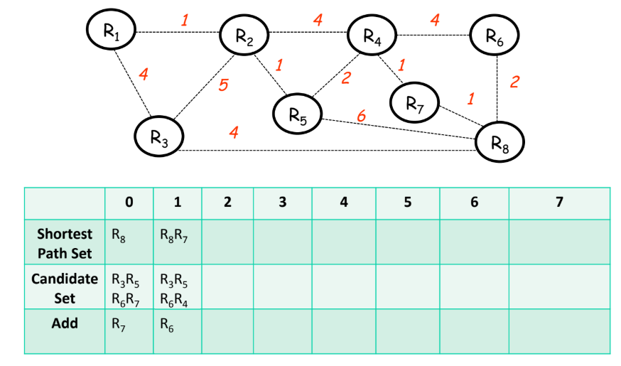
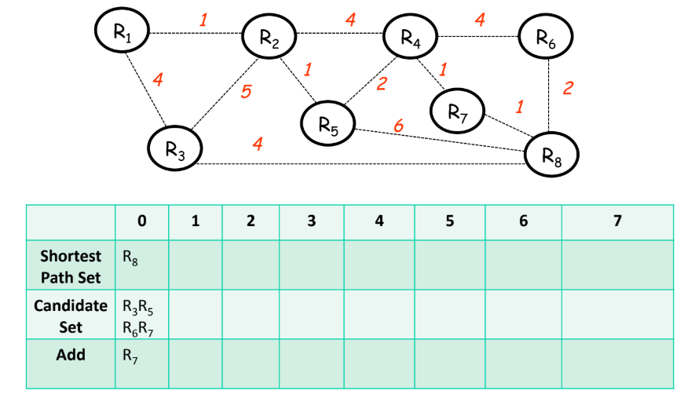
Link state example

Slide 11
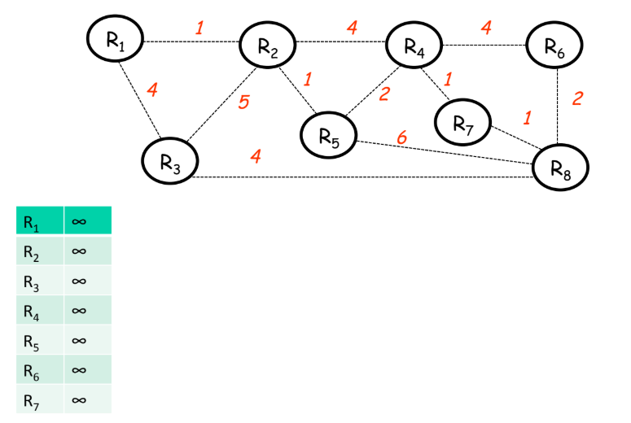
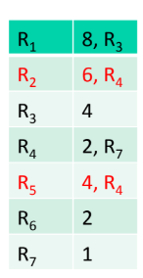
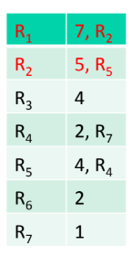
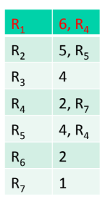
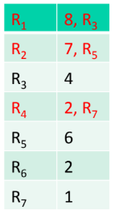
Distance vector example

Slide 12
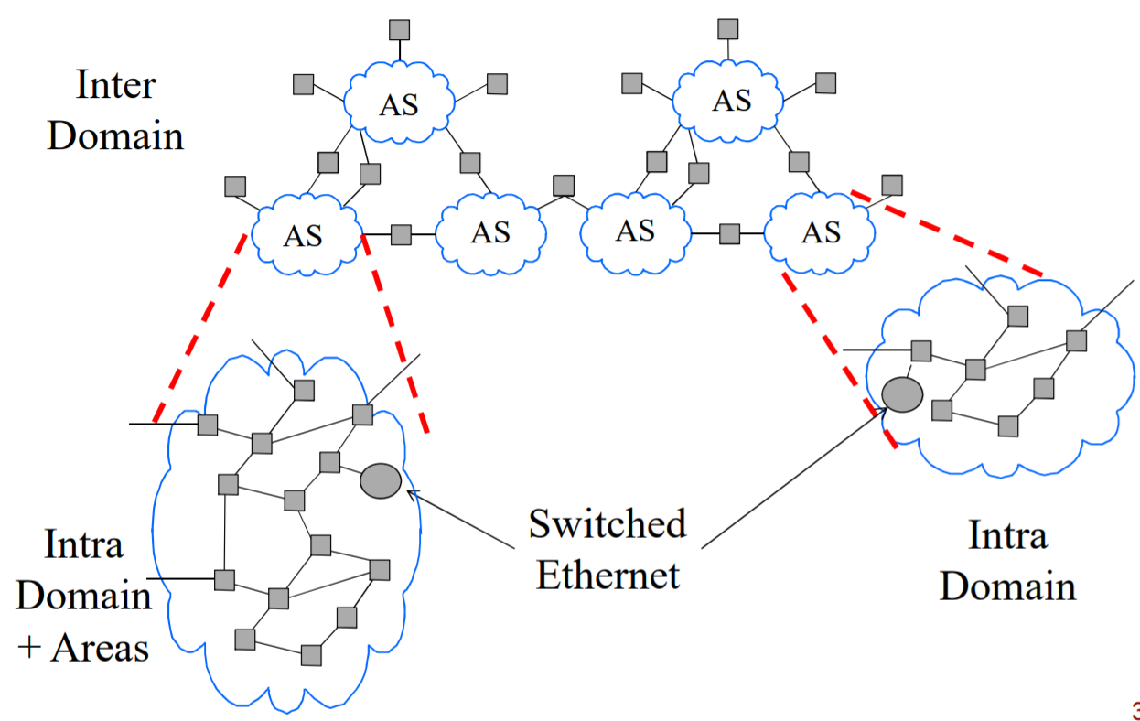
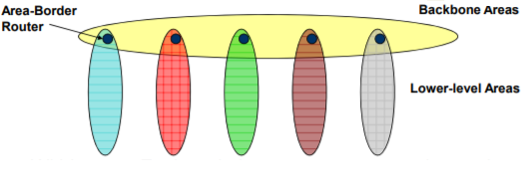
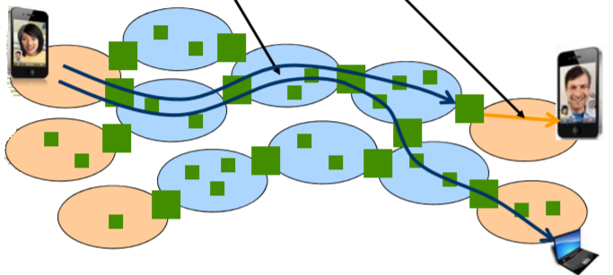
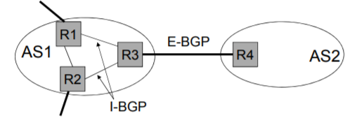
OSPF and BGP 4

Slide 13
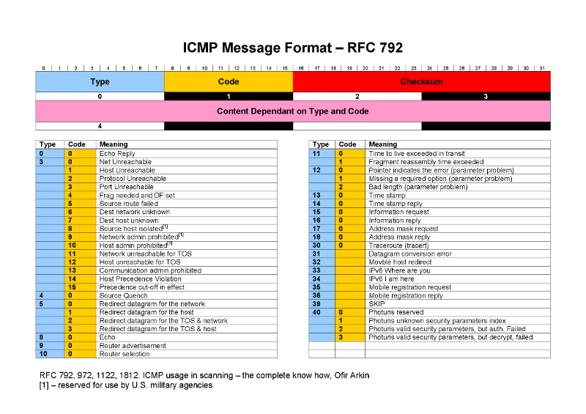

Slide 14
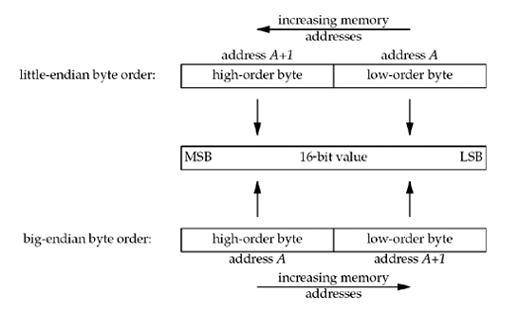
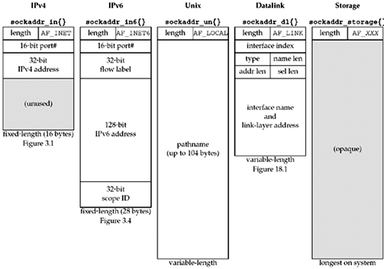


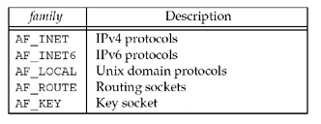
Network in Socket endpoint
Socket is endpoint with combination of network level and transport level detail.

Slide 15
Tasks for Today
Commands for today
Windows - tracert,pathping
Linux -traceroute
Both-route,ping
IP Packet analyzing
Start recording traffic, choose a website that transfers HTTP data like www.msitprogram.net
Pause/stop the recording.
Observe packet at IP level, notice source and destination addresses.
Notice elements of IP header such as fragment ID, TTL, network protocol.
Spanning tree for given graphs using Dijkstra and Bellman-ford algorithm.
Write a socket program (with UDP in transport with port no 2020), that sends your roll number to everyone in group (lab).
Program has static data of group roll numbers, IP addresses.
When roll number is received, program marks the roll call. Displays absent members.

Slide 16
References
IPv6: https://tools.ietf.org/html/rfc2460
Bellman ford algorithm: https://www.youtube.com/watch?v=mShj-x3RMJQ&t=35
Dijkstra's shortest path algorithm:https://www.youtube.com/watch?v=cONKcx39Q3U&t=27
Endianness :https://en.wikipedia.org/wiki/Endianness
NAT: https://computer.howstuffworks.com/nat.htm
Routing: https://en.wikipedia.org/wiki/Routing

Slide 17
Question and Answers (Q&A)
Thank you.

